Slide 1
Rehabilitation Driving Simulator
1/21/19
Marissa Alvarez, Geoff Colman, Simon Wroblewski, Jackson Myers

Slide 2
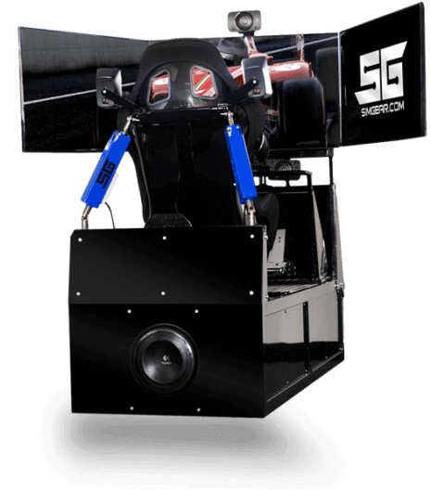
Project Description
Conventional therapeutic simulators don’t provide motion feedback, and full motion feedback from commercial simulators can be too stressful for patients.
This project aims to develop a driving simulator capable of providing haptic feedback that can help rehabilitate drivers who have suffered from, e.g., a stroke, brain trauma, etc.
The purpose of our software is to help manage the simulator hardware and the user sessions by launching user sessions, tracking user data (e.g. times, driving violations, and personal settings), and providing scenarios.

Slide 3

Project Goals
Prof. Smith (our customer) needs a research tool to aid long-term development of therapies and strategies:
Prof. Smith and our team will run experiments on both injured and able-bodied participants, with and without haptic feedback.
The customer wants to be able to demonstrate therapeutic effectiveness of the haptics in order to guide future treatment.
The goal of our software is to manage this research project:
The scheduler client will act as an organizational tool for coordinating trials and handling data collected by our telemetry module.
We will build training and evaluation scenarios for research purposes.

Slide 4
Project Justification
The long-term goal of the project - aiding in the recovery of people with illness and injury - is for the greater good.
Mastering the interaction of simulator hardware, controller firmware, and the existing simulator software.
We possess all the off-the-shelf software and hardware.
Writing relevant custom code blocks to fulfill our needs is within our skillset.
Combining our programming skills with interpersonal skills.
Working with an outside customer and group.
Supervising research trials with volunteers.

Slide 5
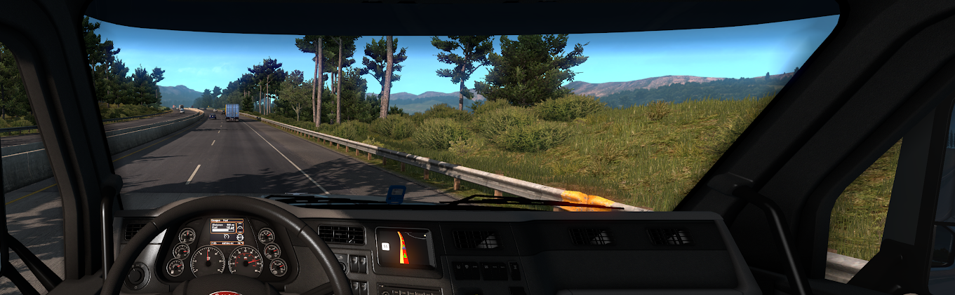
How It Works
One or more team members will conduct a session with an individual.
Our software will tailor the session experience to the individual via their user profile.
Each session will consist of training (through track and open road driving) and test scenarios.
Data will be collected during each session and analyzed afterward.
Results of this data analysis will be used to determine driver’s progress.

Slide 6
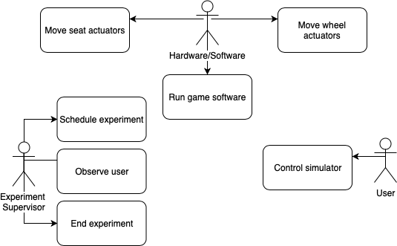
Use Case Diagrams

Slide 7
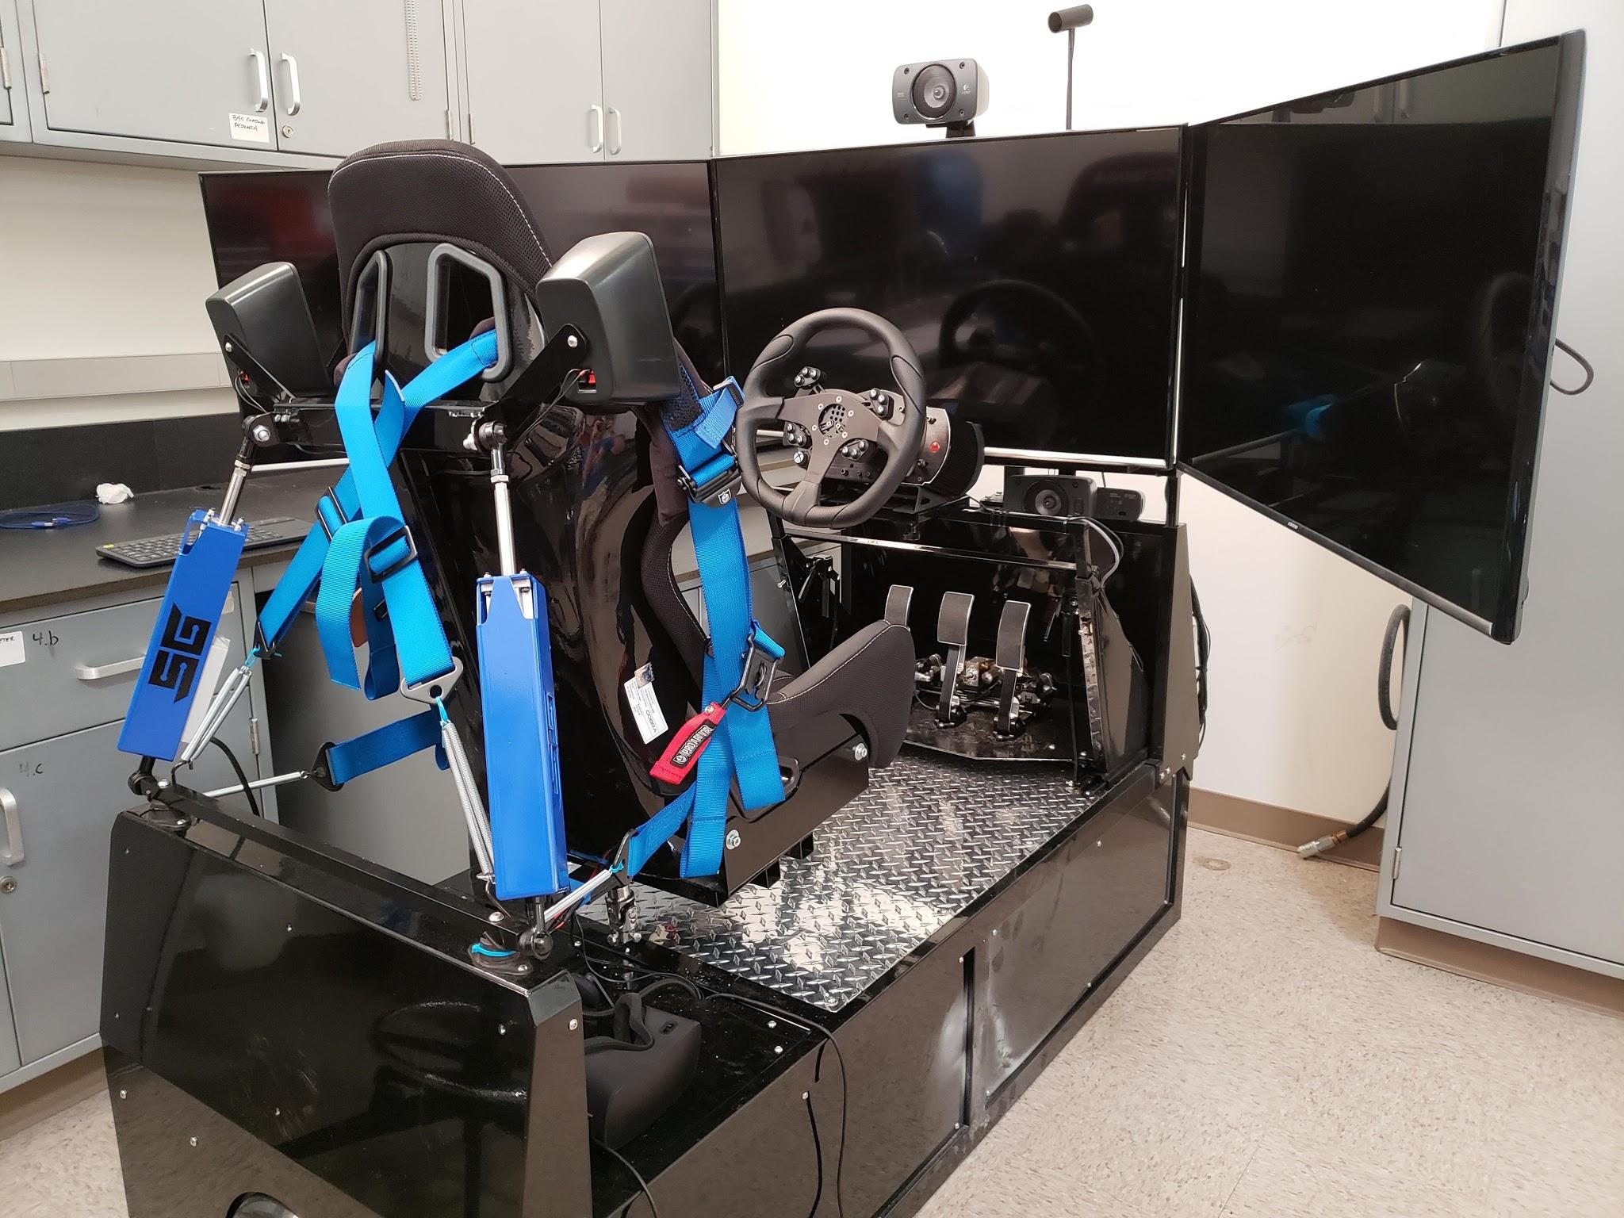
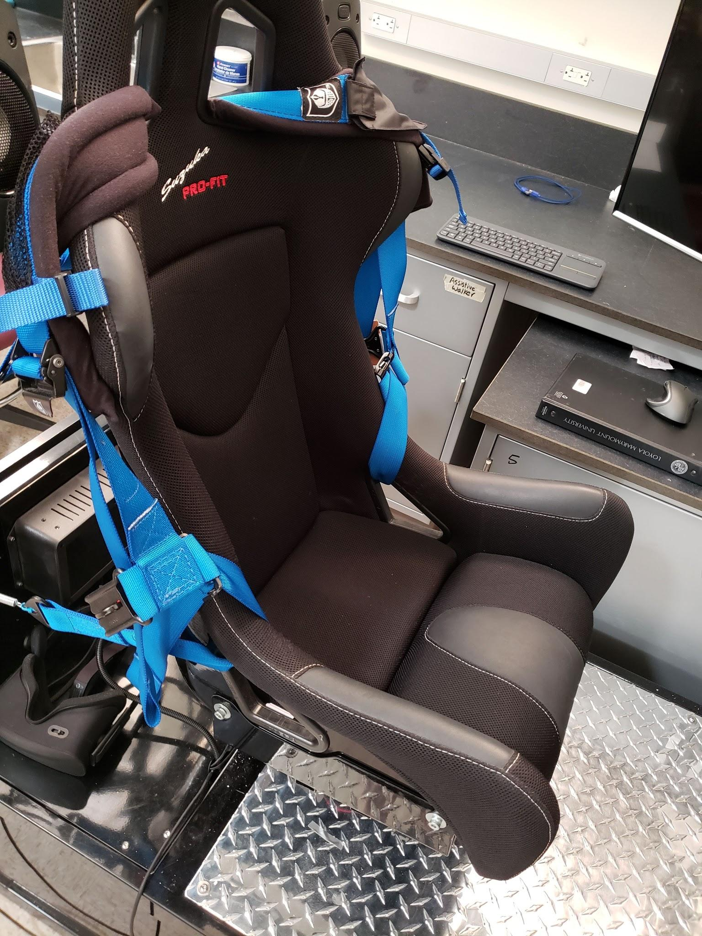
User Interface

Slide 8
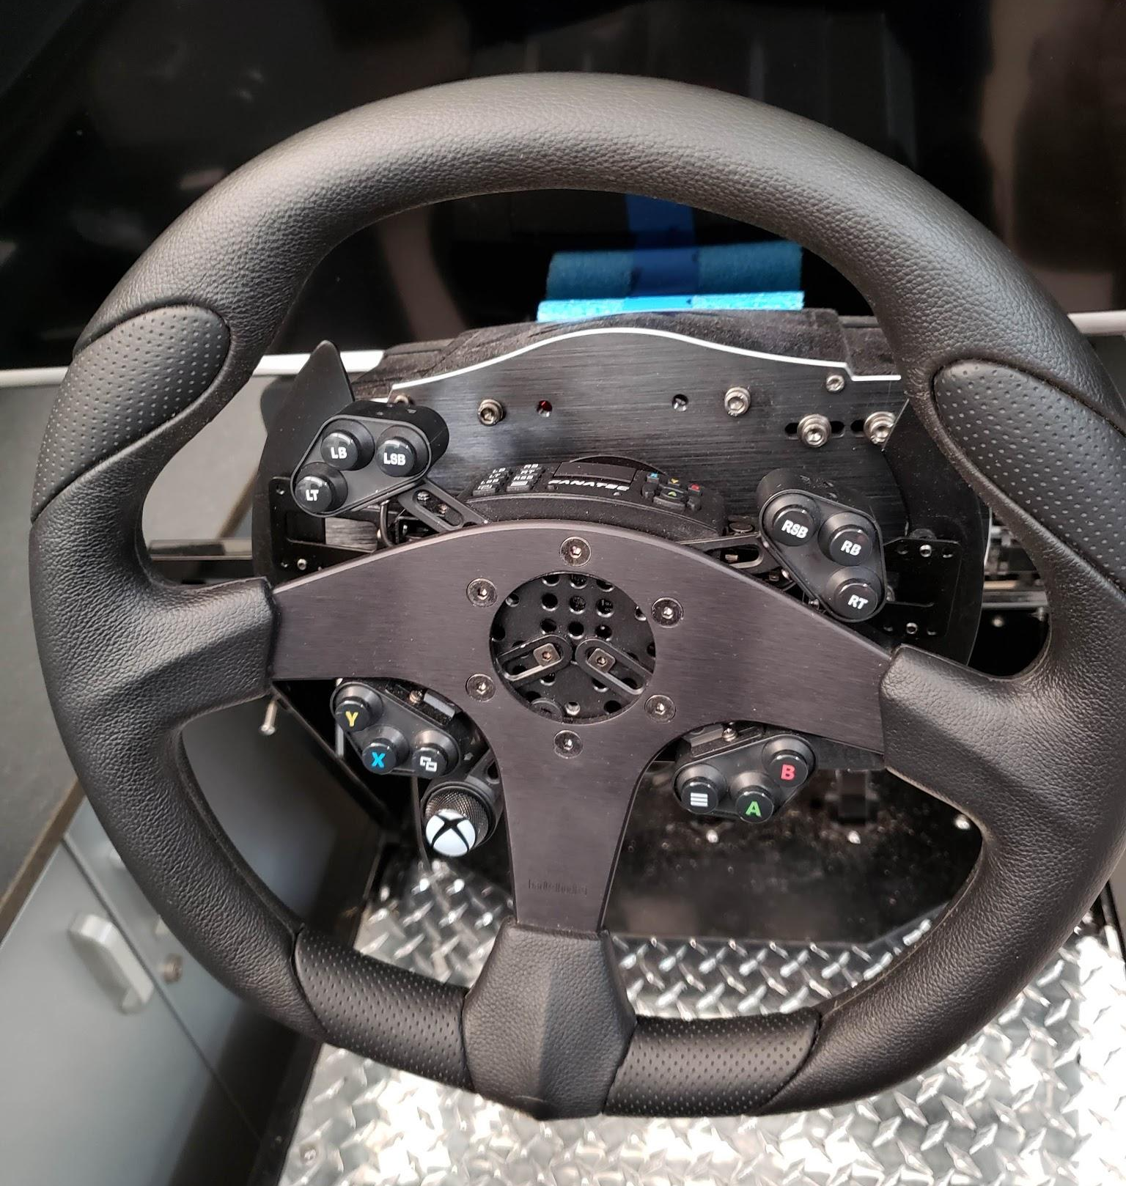
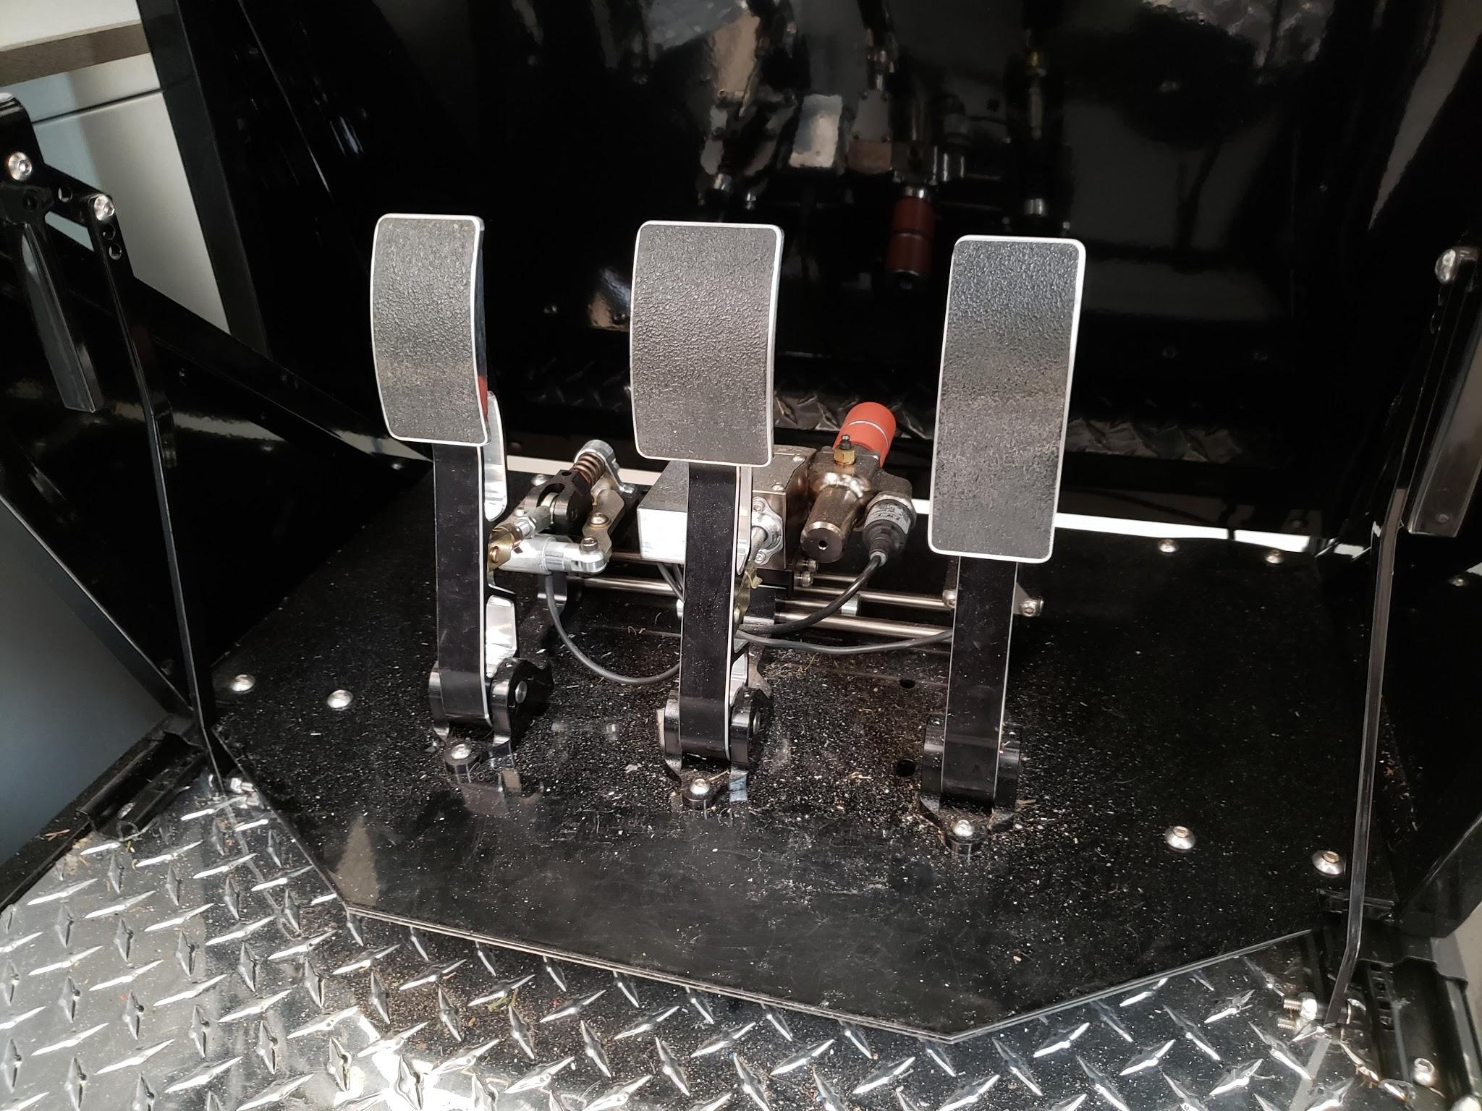
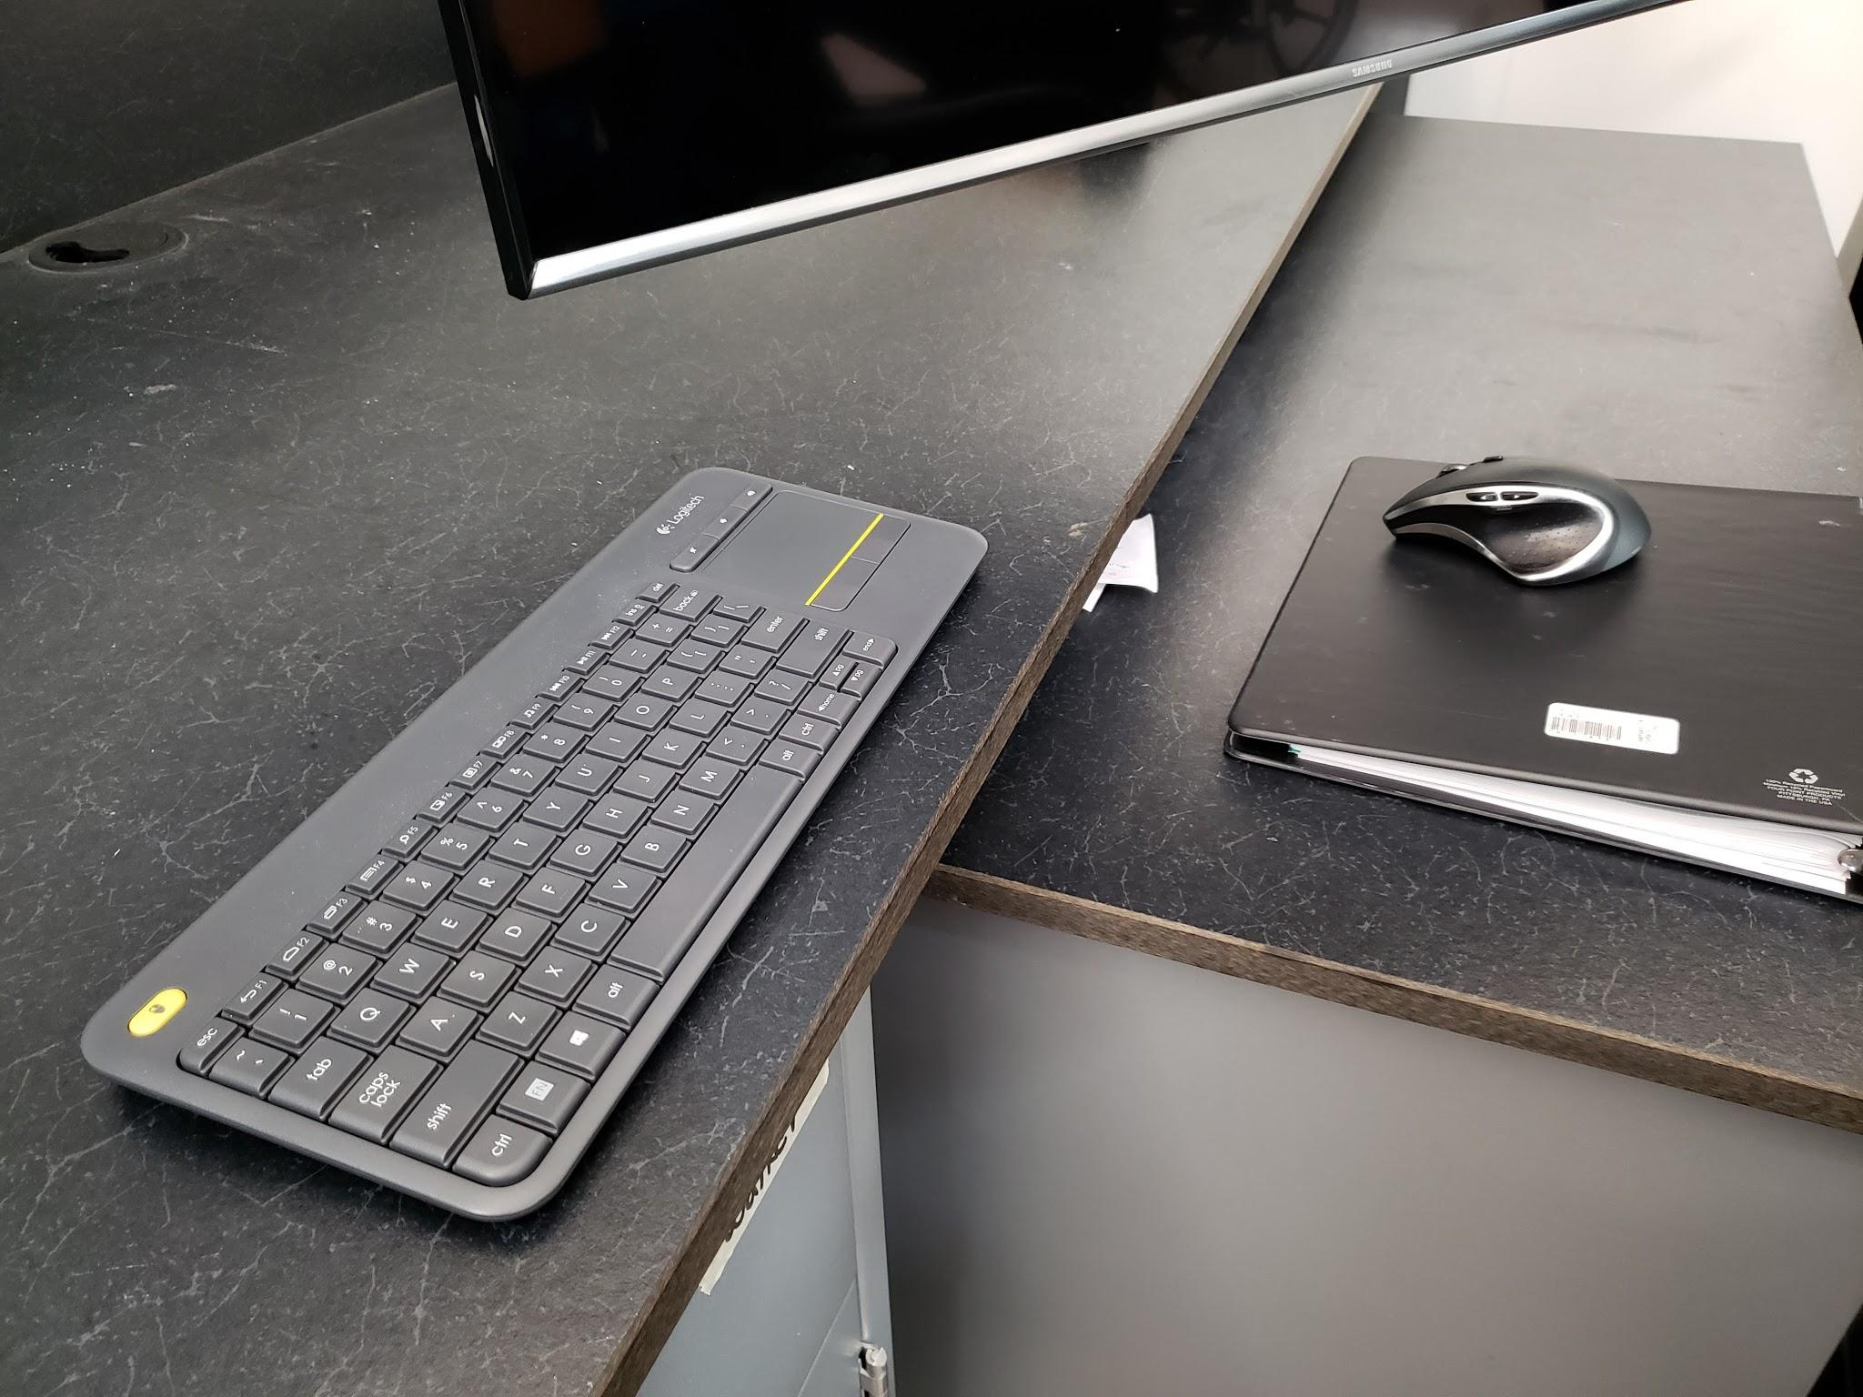
User Interface, cont.’d

Slide 9
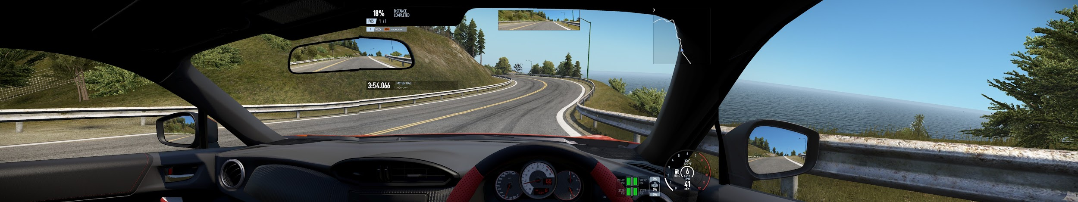
User Interface, cont.’d

Slide 10
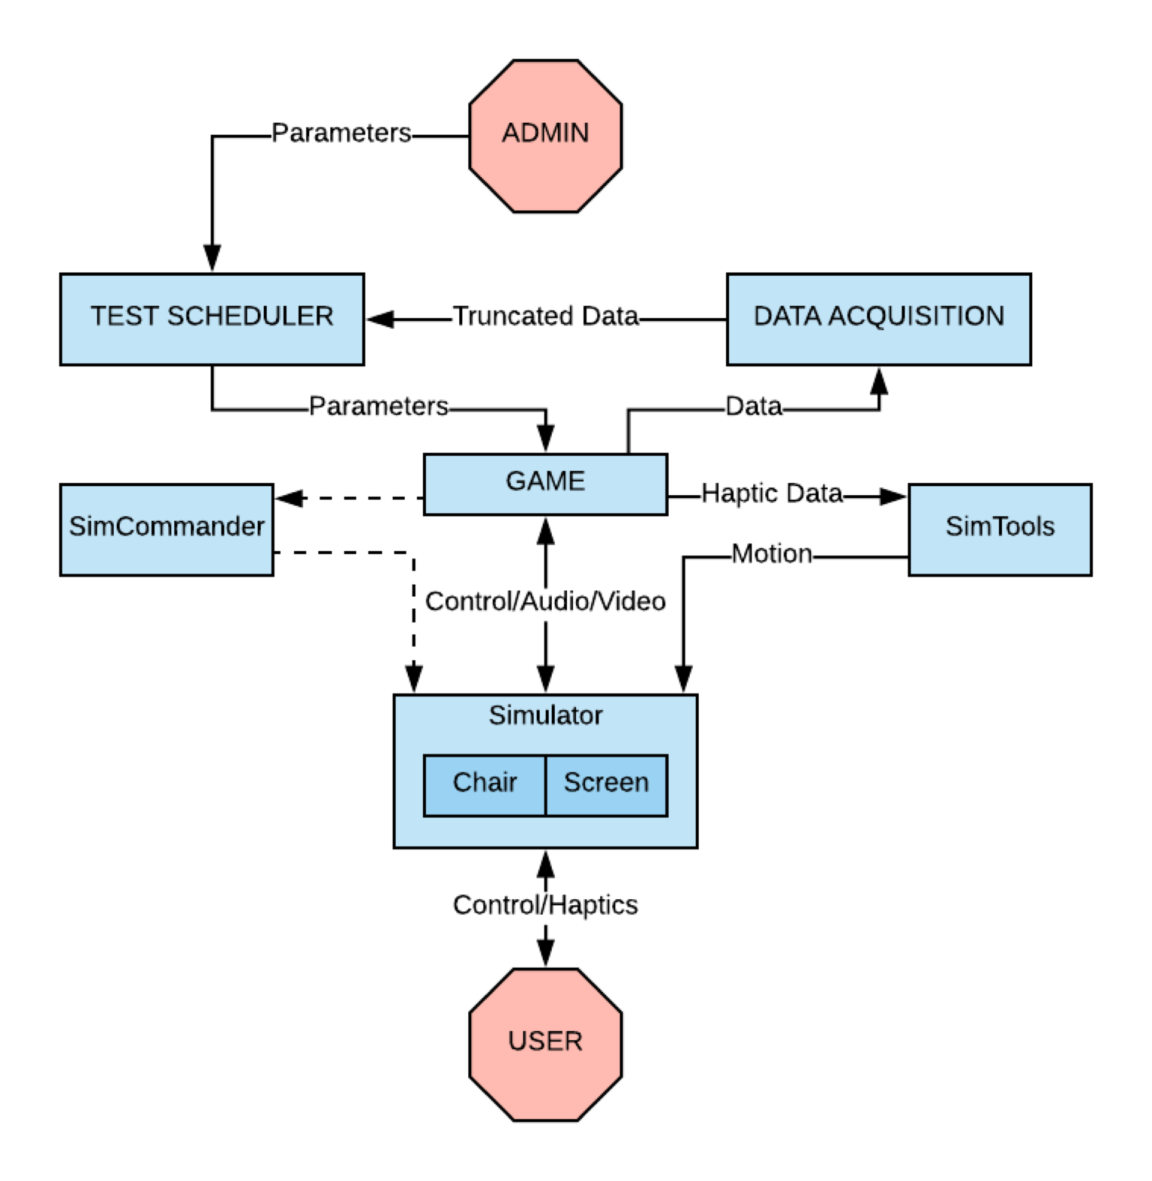
Detailed Diagram

Slide 11
Status Update from Fall Semester
Progress:
Telemetry system is functioning nominally
Have fine-tuned experiment protocol with Dr. Smith and his team.
Started running preliminary training experiments with members of our team using OTS software.
Next steps:
Need to further fine-tune the telemetry system in order to build a template for “ideal” map
Work on getting telemetry system to recognize pedal input
Design, implement Experiment Scheduler GUI
 | Minor issue with pedal input not being recognized by Sim Commander telemetry system Dr. Smith’s team hasn’t figured it out, and Geoff spent an hour trying to figure it out week before last Difficulty in testing telemetry DLL that can only operate within the top-level software by calling telemetry API.
 | Might need assistance from hardware and software vendor regarding the pedal issue

Slide 12
Our Plans for this Semester
Build out experimental environment
Maps/tracks
Events/behaviors
Build Experiment Scheduler GUI
Create a system for logging customers’ performance
Create a system for evaluating customers’ performance
Take turns proctoring experiments
Keep our customer in the loop!

Slide 13
THANK YOU!

Slide 14
Questions
?
??
???

